Slide 1
32-Bit MIPS Processor with 5 Stage Pipeline in Modelsim
Names: Omer Al Sumeri Course: ECE 174
Luigi Santiago Professor: Dr. El-Razouk
Aryan Singh

Slide 2
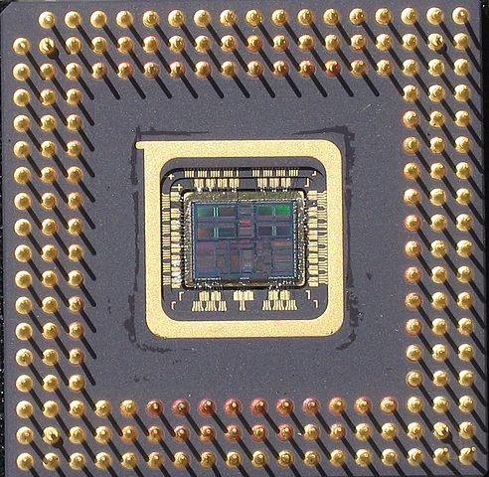
What we will be Discussing today
Project Goal
Basic MIPS Background
Main Modules needed for Processor
Wiring Schematic Display
Program Demonstration

Slide 3
Project Goal

Slide 4
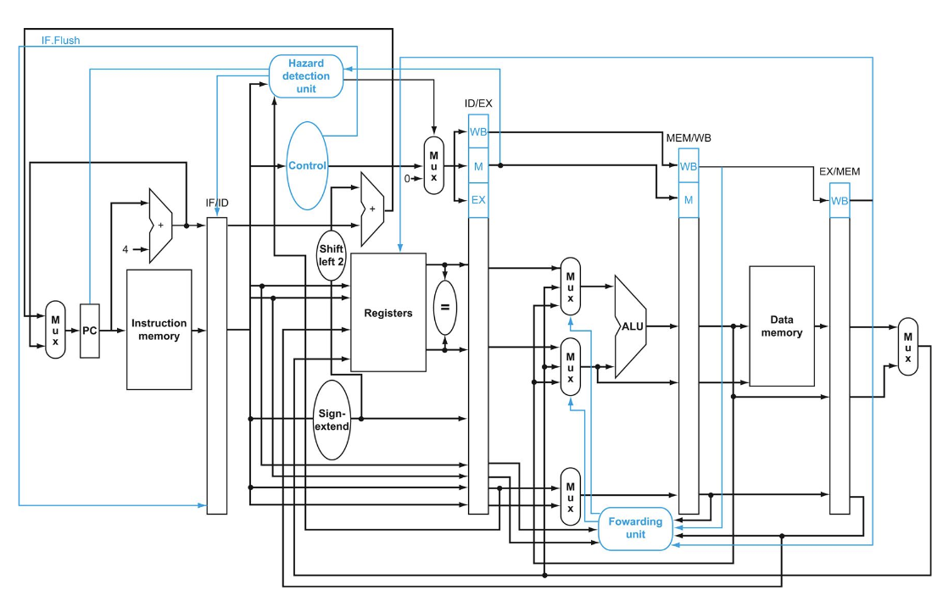
Project Goal
Implement a 32-bit processor with 5 stage pipeline that will be able to execute a program created off the MIPS ISA
Instructions it will support:
Arithmetic/Logic: AND, OR , NOR, ADD, SUB, SLT, ADDI, MULTI, DIV
Data movement: LW , SW, MFHI, and MFLO
Flow control: Beq, j
Must support forwarding values and stalling

Slide 5
Basic MIPS Background

Slide 6
MIPS Architecture
Register File contains 32 32-bit registers
Zero register always contains the register value of zero
Instruction memory file has a data width of 8 bits
Fixed 32-bit instruction width
5 pipeline stages: IF, ID, EX, MEM, WB

Slide 7
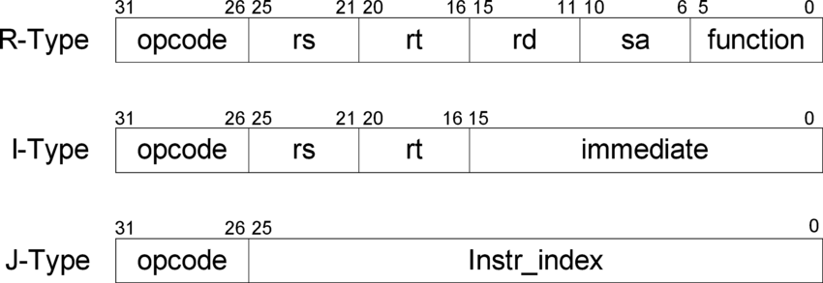
MIPS Instruction Format
6 Bit OpCode
RS field in I-Type Instruction is the base address for SW and LW

Slide 8
Main Modules needed for Processor

Slide 9
Main Modules Needed
Instruction Memory
Data Memory Module
ALU
Forwarding Unit
Hazard Detection Unit
Main Control Module
Four Pipeline Modules
IF_ID
ID_EX
EX_MEM
MEM_WB
Multiple MUX’s

Slide 10
Wiring Schematic Display

Slide 11
Wiring Schematic Display
To help with troubleshooting, a wiring diagram was created
All data bus widths are defined
All MUX’s are defined
All wire numbers used to connect all the modules together are labeled

Slide 12
Program Demonstration

Slide 13
Program Demonstration
We will have a live demonstration for 2 programs
One program will demonstrate the following instructions:
Multiply
Divide
MFLO
SUB
The other program will demonstrate the following instructions:
ADD
Branch if Equal
Forwarding

Slide 14

Program 1 Demonstration
Program Code is the following
Div $16, $17
MFLO $8
MULT $8, $17
MFLO $8
SUB $2, $16, $8
Initial Registers:
$16 = 10 (a)
$17 = 3 (b)
Final Register:
$2 (r)

Slide 15
Program 2 Demonstration
Program Code is the following
0 ADD $8, $2, $1
4 ADD $2, $8, $11
8 BEQ $0, $0, 1 (Jump to address 16)
12 ADD $3, $9, $10
16 ADD $3, $zero, $10
Tests Branch if equal and Forwarding Unit works
Initial Registers:
$8 = 0 , $0 = 0 , $2 = 3 ,$1=3
$9 = 10, $10 = 10, $11 = 4

Slide 16
Conclusion & Future work

Slide 17
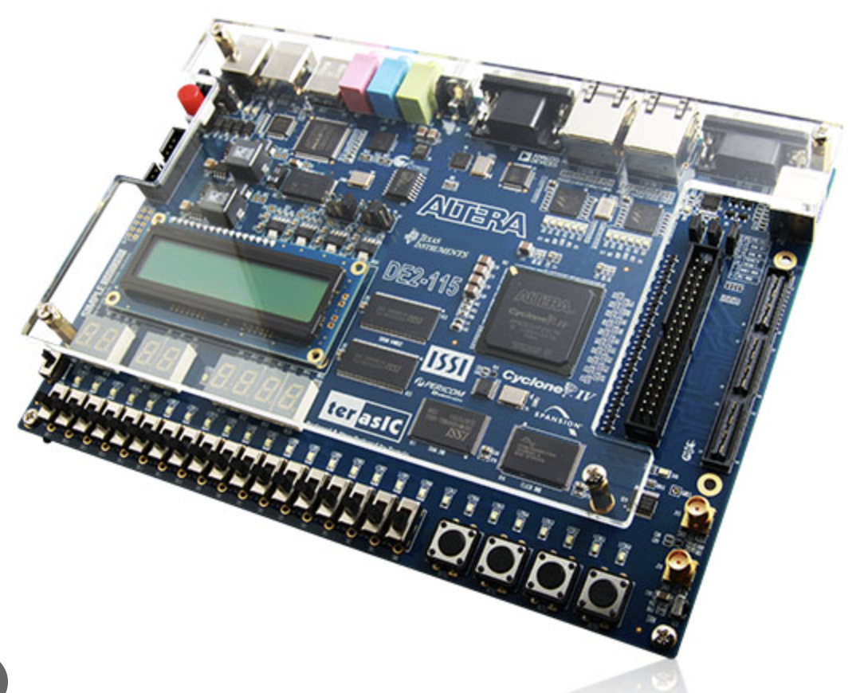
Conclusion & Future work
In this project we created:
5 stage pipeline
Forwarding and Hazard Detection Unit
In the Future we plan to implement the MIPS architecture on a working FPGA

